Slide 1
Table Creation

Slide 2
Lecture Outline
Database Schema Overview
CREATE TABLE
Common Data Type overview
ALTER TABLE command
DROP TABLE command
FLASHBACK
In-depth assessment of Constraints
ON DELETE
CHECK constraint

Slide 3
Database Schema Objects
A Database can contain many different types of objects.
The main database object types are:
Table
Index
Constraint
View
Sequence
Synonym
Some of these object types can exist independently and others can not.

Slide 4
Database Schema Objects
Some of the object types take up space, known as storage, in the database and others do not.
Database objects taking up significant storage space are known as Segments.
Tables and Indexes are examples of Segments, as the values stored in the columns of each row take up significant physical disk space.
Views, Constraints, Sequences, and Synonyms are also objects, but the only space they require in the database is in the definition of the object—none of them have any data rows associated with them.

Slide 5
Database Schema Objects
The database stores the definitions of all database objects in the Data Dictionary, and these definitions are accessible to all users of the database as well as to the database itself.
Have you ever wondered how Oracle knows which columns to return from a Query?
For example, if you specify SELECT * FROM jobs instead of SELECT job_id, job_title FROM jobs, how does Oracle know which columns to return?
The database looks up the definition of the table used in the query, translates the '*' into the full list of columns, and returns the result to you.

Slide 6
Table Creation
All data in a relational database is stored in tables.
When creating a new table, use the following rules for table names and column names:
Must begin with a letter
Must be 1 to 30 characters long
Must contain only A -Z, a -z, 0 -9, _ (underscore), $, and #
Must not duplicate the name of another object owned by the same user
Must not be an Oracle Server reserved word

Slide 7
Naming Conventions
It is best to use descriptive names for tables and other database objects.
If a table will store information about students, name it STUDENTS, not PEOPLE or CHILDREN.
Table names are not case sensitive.
For example, STUDENTS is treated the same as STuDents or students.
Table names should be plural, for example STUDENTS, not student.
Creating tables is part of SQL's data definition language (DDL).
Other DDL statements used to set up, change, and remove data structures from tables include ALTER, DROP, RENAME, and TRUNCATE

Slide 8
CREATE TABLE
To create a new table, you must have the CREATE TABLE privilege and a storage area for it.
The database administrator uses data control language (DCL) statements to grant this privilege to users and assign a storage area.
Tables belonging to other users are not in your schema.
If you want to use a table that is not in your schema, use the table owner's name as a prefix to the table name:
You must be granted access to a table to be able to select from it.
SELECT *
FROM mary.students;

Slide 9
CREATE TABLE Syntax
To create a new table, use the following syntax details:
table is the name of the table, column is the name of the column
Data type is the column's data type and length
DEFAULT expression specifies a default value if a value is omitted in the INSERT statement
CREATE TABLE table
(column data type [DEFAULT expression],
(column data type [DEFAULT expression],
(……[ ] );
CREATE TABLE my_cd_collection
(cd_number NUMBER(3),
title VARCHAR2(20),
artist VARCHAR2(20),
purchase_date DATE DEFAULT SYSDATE);

Slide 10
Data Dictionary
Two kinds of tables exists in an Oracle Database: User tables and Data Dictionary tables.
You can issue SQL statements to access both kinds of tables—you can select, insert, update, and delete data in the user tables, and you can select data in the Data Dictionary tables.
User tables created by you containing your data:
Employees, departments, jobs, etc.
Data Dictionary tables:
DICTIONARY, USER_OBJECTS, USER_TABLES, USER_SEGMENTS, USER_INDEXES, etc.

Slide 11
Data Type Overview
Each value manipulated by Oracle has a data type.
A value's data type associates a fixed set of properties with the value.
These properties cause the database to treat values of one data type differently from values of another data type.

Slide 12
Data Type Overview
Different data types offer several advantages:
Columns of a single type produce consistent results.
For example, DATE data type columns always produce date values.
You cannot insert the wrong type of data into a column. For example, columns of data type DATE will prevent NUMBER type data from being inserted.
For these reasons, each column in a relational database can hold only one type of data.
You cannot mix data types within a column

Slide 13
Common Data Types
The most commonly used column data types for character and number values are below.
For character values:
CHAR (fixed size, maximum 2000 characters)
VARCHAR2 (variable size, maximum 4000 characters)
CLOB (variable size, maximum 128 terabytes)
For number values:
NUMBER (variable size, maximum precision 38 digits)

Slide 14
Common Data Types
The most commonly used column data types for date, time, and binary values are below.
For date and time values:
DATE
TIMESTAMP ….
INTERVAL
For binary values (eg. multimedia: JPG, WAV, MP3, and so on):
RAW (variable size, maximum 2000 bytes)
BLOB (variable size, maximum 128 terabytes)

Slide 15
Common Data Types
For character values, it is usually better to use VARCHAR2 or CLOB than CHAR, because it saves space.
For example, an employee's last name is 'Chang'.
In a VARCHAR2(30) column, only the 5 significant characters are stored: C h a n g.
But in a CHAR(30) column, 25 trailing spaces would be stored as well, to make a fixed size of 30 characters.
Number values can be negative as well as positive. For example, NUMBER(6,2) can store any value from +9999.99 down to –9999.99.

Slide 16
DATE-TIME Data Types
The DATE data type stores a value of centuries down to whole seconds, but cannot store fractions of a second.
'21-Aug-2003 17:25:30' is a valid value, but '21-Aug-2003 17:25:30.255' is not.
The TIMESTAMP data type is an extension of the DATE data type which allows fractions of a second.
For example, TIMESTAMP(3) allows 3 digits after the whole seconds, allowing values down to milliseconds to be stored.

Slide 17
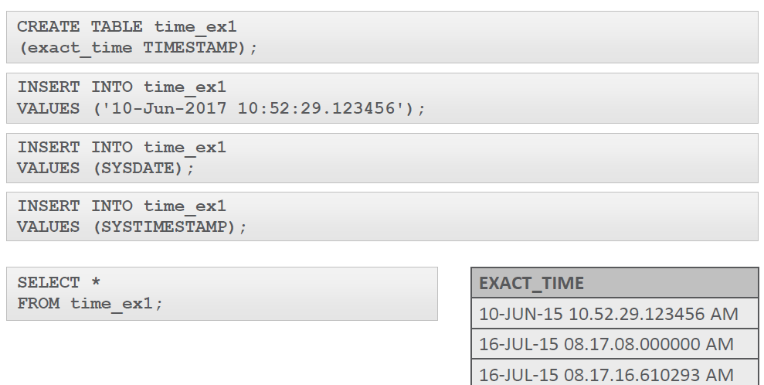
DATE-TIME Data Types
TIMESTAMP Example

Slide 18
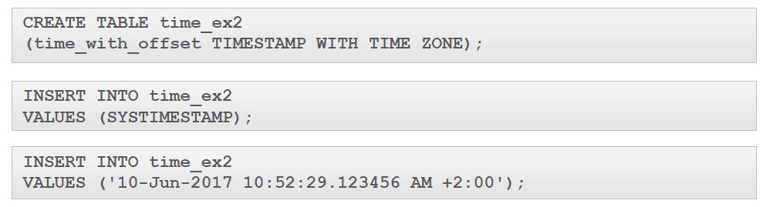
TIMESTAMP…With [LOCAL] Time Zone
TIMESTAMP WITH TIME ZONE stores a time zone value as a displacement from Universal Coordinated Time or UCT (previously known as Greenwich Mean Time or GMT).
A value of '21-Aug-2003 08:00:00 –5:00' means 8:00 am 5 hours behind UTC.
This is US Eastern Standard Time (EST).

Slide 19
ALTER Tables
ALTER TABLE statements are used to:
Add a new column
Modify an existing column
Define a DEFAULT value for a column
Drop a column
You can add or modify a column in a table, but you cannot specify where the column appears.

Slide 20
ALTER Tables
A newly added column always becomes the last column of the table.
Also, if a table already has rows of data and you add a new column to the table, the new column is initially null for all of the pre-existing the rows.
To add a new column, use the SQL syntax shown:
ALTER TABLE tablename
ADD (column name data type [DEFAULT expression],
Column name data type [DEFAULT expression], …
ALTER TABLE my_cd_collection
ADD (release_dateDATE DEFAULT SYSDATE);

Slide 21
ALTER TABLE: Modifying a Column
Modifying a column can include changes to a column's data type, size, and DEFAULT value.
Rules and restrictions when modifying a column are:
You can increase the width or precision of a numeric column.
You can increase the width of a character column.
You can decrease the width of a NUMBER column if the column contains only null values, or if the table has no rows.
For VARCHAR types, you can decrease the width down to the largest value contained in the column.

Slide 22
ALTER TABLE: Modifying a Column
You can change the data type only if the column contains null values.
You can convert a CHAR column to VARCHAR2 or convert a VARCHAR2 COLUMN to CHAR only if the column contains null values, or if you do not change the size to something smaller than any value in the column.
A change to the DEFAULT value of a column affects only later insertions to the table.

Slide 23
ALTER TABLE: Dropping a Column
When dropping a column the following rules apply:
A column containing data may be dropped.
Only one column can be dropped at a time.
You can't drop all of the columns in a table; at least one column must remain.
Once a column is dropped, the data values in it cannot be recovered.
Syntax
ALTER TABLE tablename
DROP COLUMN column name;
ALTER TABLE my_cd_collection
DROP COLUMN release_date;

Slide 24
DROP TABLE
The DROP TABLE statement removes the definition of an Oracle table.
The database loses all the data in the table and all the indexes associated with it.
When a DROP TABLE statement is issued:
All data is deleted from the table.
The table's description is removed from the Data Dictionary.
The Oracle Server does not question your decision and it drops the table immediately.

Slide 25
DROP TABLE
In the next slide, you will see that you may be able to restore a table after it is dropped, but it is not guaranteed.
Only the creator of the table or a user with DROP ANY TABLE privilege (usually only the DBA) can remove a table.
Syntax:
Example:
DROP TABLE tablename;
DROP TABLE copy_employees;

Slide 26
FLASHBACK Table
If you drop a table by mistake, you may be able to bring that table and its data back.
Each database user has his own recycle bin into which dropped objects are moved, and they can be recovered from here with the FLASHBACK TABLE command.
This command can be used to restore a table, a view, or an index that was dropped in error.
The Syntax is:
FLASHBACK TABLE tablename TO BEFORE DROP;

Slide 27
FLASHBACK Table
For example, if you drop the EMPLOYEES table in error, you can restore it by simply issuing the command:
As the owner of a table, you can issue the flashback command, and if the table that you are restoring had any indexes, then these are also restored.
It is possible to see which objects can be restored by querying the data dictionary view USER_RECYCLEBIN.
FLASHBACK TABLE copy_employees TO BEFORE DROP;

Slide 28
RENAME
To change the name of a table, use the RENAME statement.
This can be done only by the owner of the object or by the DBA.
Syntax:
Example:
We will see later that we can rename other types of objects such as views, sequences, and synonyms.
RENAME old_name to new_name;
RENAME my_cd_collection TO my_music;

Slide 29
TRUNCATE
Truncating a table removes all rows from a table and releases the storage space used by that table.
When using the TRUNCATE TABLE statement:
You cannot roll back row removal.
You must be the owner of the table or have been given DROP ANY TABLE system privileges.

Slide 30
TRUNCATE
Syntax:
The DELETE statement also removes rows from a table, but it does not release storage space.
TRUNCATE is faster than DELETE because it does not generate rollback information.
TRUNCATE TABLE tablename;

Slide 31
TRUNCATE
You can add a comment of up to 2,000 characters about a column, table, or view by using the COMMENT statement.
Syntax:
Example:
COMMENT ON TABLE tablename | COLUMN table.column
IS 'place your comment here';
COMMENT ON TABLE employees
IS 'Western Region only';

Slide 32
FLASHBACK Query
You may discover that data in a table has somehow been inappropriately changed.
Luckily, Oracle has a facility that allows you to view row data at specific points in time, so you can compare different versions of a row over time.
This facility is very useful.
Imagine, for instance, that someone accidently performs some DML on a table, and then executes a COMMIT on those changes.

Slide 33
FLASHBACK Query
You can use the FLASHBACK QUERY facility to examine what the rows looked like BEFORE those changes were applied.
When Oracle changes data, it always keeps a copy of what the amended data looked like before any changes were made.
So it keeps a copy of the old column value for a column update, it keeps the entire row for a delete, and it keeps nothing for an insert statement.
These old copies are held in a special place called the UNDO tablespace.
Users can access this special area of the Database using a flashback query.
You can look at older versions of data by using the VERSIONS clause in a SELECT statement

Slide 34
FLASHBACK Query
For example:
The SCN number referred to in the above query means the System Change Number and is a precise identification of time in the database.
It is a sequential number incremented and maintained by the database itself.
SELECT employee_id,first_name ||' '|| last_name AS "NAME",
versions_operation AS "OPERATION",
versions_starttime AS "START_DATE",
versions_endtime AS "END_DATE", salary
FROM employees
VERSIONS BETWEEN SCN MINVALUE AND MAXVALUE
WHERE employee_id = 1;

Slide 35

FLASHBACK Query - Example
Lets create an employee for this example:
INSERT INTO copy_employees
VALUES (1, 'Natacha', 'Hansen', 'NHANSEN', '4412312341234',
'07-SEP-1998', 'AD_VP', 12000, null, 100, 90, NULL);
SELECT employee_id,first_name ||' '|| last_name AS "NAME",
versions_operation AS "OPERATION",
versions_starttime AS "START_DATE",
versions_endtime AS "END_DATE", salary
FROM copy_employees
VERSIONS BETWEEN SCN MINVALUE AND MAXVALUE
WHERE employee_id = 1;

Slide 36
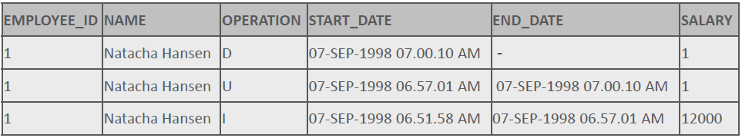
FLASHBACK Query - Example
Then you can delete the row:
DELETE from copy_employees
WHERE employee_id= 1;
SELECT employee_id,first_name ||' '|| last_name AS "NAME",
versions_operation AS "OPERATION",
versions_starttime AS "START_DATE",
versions_endtime AS "END_DATE", salary
FROM copy_employees
VERSIONS BETWEEN SCN MINVALUE AND MAXVALUE
WHERE employee_id = 1;

Slide 37
Constraints
So, what exactly is a constraint?
Think of constraints as database rules.
All constraint definitions are stored in the data dictionary.
Constraints prevent the deletion of a table if there are dependencies from other tables.
Constraints enforce rules on the data whenever a row is inserted, updated, or deleted from a table
Constraints are important and naming them is also important.
Although you could name a constraint "constraint_1" or "constraint_2," you'd soon find it difficult to distinguish one constraint from another and would end up redoing a lot of work.

Slide 38
Creating Constraints
You use the CREATE TABLE statement to establish constraints for each column in the table.
There are two different places in the CREATE TABLE statement that you can specify the constraint details:
At the column level next to the name and data type
At the table level after all the column names are listed

Slide 39
Constraints at Column Level
A column-level constraint references a single column.
To establish a column-level constraint, the constraint must be defined in the CREATE TABLE statement as part of the column definition.
Examine the following SQL statement that establishes a column-level constraint.
The name of the constraint is clients_client_num_pk.
It enforces the business rule that the client_number is the primary key of the clients table.
CREATE TABLE clients
(client_number NUMBER(4) CONSTRAINT clients_client_num_pk PRIMARY KEY,
first_name VARCHAR2(14),
last_name VARCHAR2(13));
Make your constraint names descriptive.

Slide 40
Constraints at the Table Level
Table-level constraints are listed separately from the column definitions in the CREATE TABLE statement.
Table-level constraint definitions are listed after all the table columns have been defined.
In the example shown, the unique constraint is listed last in the CREATE TABLE statement.
CREATE TABLE clients (
client_number NUMBER(6) NOT NULL,
first_name VARCHAR2(20),
last_name VARCHAR2(20),
phone VARCHAR2(20),
email VARCHAR2(10) NOT NULL,
CONSTRAINT clients_phone_email_uk UNIQUE (email,phone));

Slide 41
Basic Rules for Constraints
Constraints that refer to more than one column (a composite key) must be defined at the table level
The NOT NULL constraint can be specified only at the column level, not the table level
UNIQUE, PRIMARY KEY, FOREIGN KEY, and CHECK constraints can be defined at either the column or table level
If the word CONSTRAINT is used in a CREATE TABLE statement, you must give the constraint a name

Slide 42
Examine the Violations
COMPOSITE UNIQUE KEY VIOLATION
Composite keys must be defined at the table level.
CREATE TABLE clients(
client_numberNUMBER(6),
first_nameVARCHAR2(20),
last_nameVARCHAR2(20),
phone VARCHAR2(20) CONSTRAINT phone_email_uk
UNIQUE(email,phone),
email VARCHAR2(10) CONSTRAINT NOT NULL,
CONSTRAINT emailclients_emailNOT NULL,
CONSTRAINT clients_client_num_pkPRIMARY KEY (client_number));
NOT NULL VIOLATION
NOT NULL constraints can only be
defined at the column level.
NAME VIOLATION
When using the term CONSTRAINT,
it must be followed by a constraint name.

Slide 43
Five Types of Constraints
Five types of constraints exist within an Oracle database.
Each type enforces a different rule.
The types are:
NOT NULL constraints
UNIQUE constraints
PRIMARY KEY constraints
FOREIGN KEY constraints
CHECK constraints

Slide 44
NOT NULL Constraint
A column defined with a NOT NULL constraint requires that for every row entered into the table, a value must exist for that column.
For example, if the email column in an employees table was defined as NOT NULL, every employee entered into the table MUST have a value in the email column.
When defining NOT NULL columns, it is customary to use the suffix _nn in the constraint name.

Slide 45
UNIQUE Constraint
A UNIQUE constraint requires that every value in a column or set of columns (a composite key) be unique; that is, no two rows of a table can have duplicate values.
For example, it may be important for a business to ensure that no two people have the same email address.
The email column could be defined using a UNIQUE constraint.
The column or set of columns that is defined as UNIQUE is called a unique key.
If the combination of two or more columns must be unique for every entry, the constraint is said to be a composite unique key.
Stating that all combinations of email and last name must be UNIQUE is an example of a composite unique key.
The word "key" refers to the columns, not the constraint names.

Slide 46
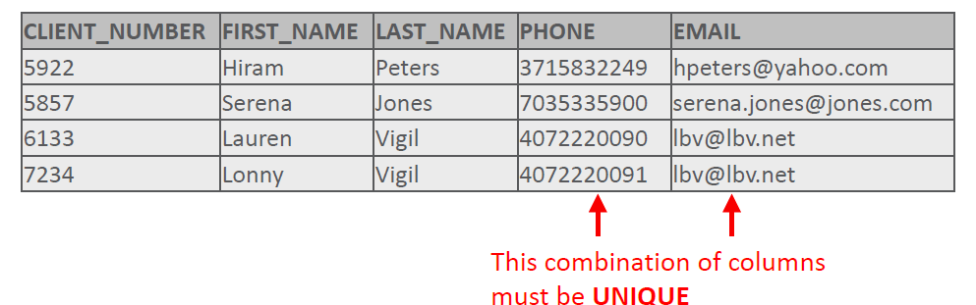
Defining UNIQUE Constraints
When defining UNIQUE constraints, it is customary to use the suffix _uk in the constraint name.
For example, the constraint name for the UNIQUE email column in the employees table could be emp_email_uk.
To define a composite unique key, you must define the constraint at the table level rather than the column level.
An example of a composite unique-key constraint name is:
CONSTRAINT clients_phone_email_uk UNIQUE(email,phone)

Slide 47
Constraints Created at Table Creation
When you add a NOT NULL constraint as part of a table creation statement, the Oracle database will create a Check Constraint in the database to enforce a value in the NOT NULL column.
This constraint creation can be almost invisible to you when you create your table—Oracle just does it.

Slide 48
PRIMARY Key Constraints
A PRIMARY KEY constraint is a rule that the values in one column or a combination of columns must uniquely identify each row in a table.
No primary-key value can appear in more than one row in the table.
To satisfy a PRIMARY KEY constraint, both of the following conditions must be true:
No column that is part of the primary key can contain a null.
A table can have only one primary key.

Slide 49
PRIMARY Key Constraints
PRIMARY KEY constraints can be defined at the column or the table level.
However, if a composite PRIMARY KEY is created, it must be defined at the table level.
When defining PRIMARY KEY columns, it is a good practice to use the suffix _pk in the constraint name.
For example, the constraint name for the PRIMARY KEY column named client_number in table named CLIENTS could be clients_client_num_pk.

Slide 50
PRIMARY KEY Constraints
In a CREATE TABLE statement, the column-level PRIMARY KEY constraint syntax is stated:
Note that the column-level simply refers to the area in the CREATE TABLE statement where the columns are defined.
The table level refers to the last line in the statement below the list of individual column names.
CREATE TABLE clients
(client_number NUMBER(4) CONSTRAINT clients_client_num_pk PRIMARY KEY,
first_name VARCHAR2(14),
last_name VARCHAR2(13));

Slide 51
PRIMARY KEY Constraints
To create the PRIMARY KEY constraint at table-level the syntax is:
Note that the PRIMARY KEY column name follows the constraint type, and is enclosed in parenthesis.
To define a composite PRIMARY KEY, you must define the constraint at the table level rather than the column level.
For example, PRIMARY KEY (employee_id, start_date)
CREATE TABLE clients
(client_number NUMBER(4),
first_name VARCHAR2(14),
last_name VARCHAR2(13),
CONSTRAINT clients_client_num_pk PRIMARY KEY (client_number));

Slide 52
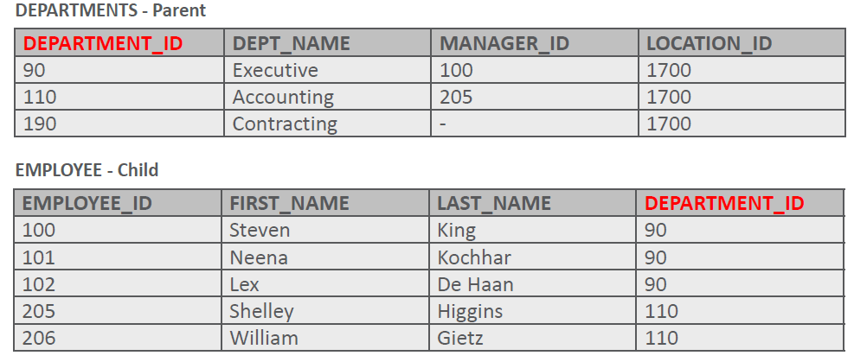
FOREIGN KEY Constraint
FOREIGN KEY constraints are also called "referential integrity" constraints.
Foreign Key constraints designate a column or combination of columns as a foreign key.
A foreign keys links back to the primary key (or a unique key) in another table, and this link is the basis of the relationship between tables.
In the tables shown, the primary-key of the DEPARTMENTS table, department_id, also appears in the EMPLOYEES table as a foreign-key column.

Slide 53
FOREGIN KEY Constraint
To define a FOREIGN KEY constraint, it is good practice to use the suffix _fk in the constraint name.
For example, the constraint name for the FOREIGN KEY column department_id in the employees table could be named emps_dept_id_fk.

Slide 54
FOREIGN KEY Constraint Syntax
The syntax for defining a FOREIGN KEY constraint requires a reference to the table and column in the parent table.
A FOREIGN KEY constraint in a CREATE TABLE statement can be defined as follows.
Column-level syntax example:
CREATE TABLE copy_employees
(employee_id NUMBER(6,0) CONSTRAINT copy_emp_pk PRIMARY KEY,
first_name VARCHAR2(20),
last_name VARCHAR2(25),
department_id NUMBER(4,0) CONSTRAINT c_emps_dept_id_fk
REFERENCES departments(department_id),
email VARCHAR2(25));

Slide 55
FOREIGN KEY Constraint Syntax
The syntax for defining a FOREIGN KEY constraint requires a reference to the table and column in the parent table.
A FOREIGN KEY constraint in a CREATE TABLE statement can be defined as follows.
Table-level syntax example:
CREATE TABLE copy_employees
(employee_id NUMBER(6,0) CONSTRAINT copy_emp_pk PRIMARY KEY,
first_name VARCHAR2(20),
last_name VARCHAR2(25),
department_id NUMBER(4,0),
email VARCHAR2(25),
CONSTRAINT c_emps_dept_id_fk FOREIGN KEY (department_id)
REFERENCES departments(department_id));

Slide 56
ON DELETE Cascade
Using the ON DELETE CASCADE option when defining a foreign key enables the dependent rows in the child table to be deleted when a row in the parent table is deleted.
If the foreign key does not have an ON DELETE CASCADE option, referenced rows in the parent table cannot be deleted.
In other words, the child table FOREIGN KEY constraint includes the ON DELETE CASCADE permission allowing its parent to delete the rows that it refers to.

Slide 57
ON DELETE CASCADE Syntax
Table created without ON DELETE CASCADE:
An attempt to delete department_id 110 from the departments table fails as there are dependent rows in the employee table.
CREATE TABLE copy_employees
(employee_id NUMBER(6,0) CONSTRAINT copy_emp_pk PRIMARY KEY,
first_name VARCHAR2(20),
last_name VARCHAR2(25),
department_id NUMBER(4,0),
email VARCHAR2(25),
CONSTRAINT cdept_dept_id_fk FOREIGN KEY (department_id)
REFERENCES copy_departments(department_id));

Slide 58
ON DELETE CASCADE Syntax
Table created without ON DELETE CASCADE:
An attempt to delete department_id 110 from the departments table succeeds, and the dependent rows in the employee table are also deleted.
1 row(s) deleted.
CREATE TABLE copy_employees
(employee_id NUMBER(6,0) CONSTRAINT copy_emp_pk PRIMARY KEY,
first_name VARCHAR2(20),
last_name VARCHAR2(25),
department_id NUMBER(4,0),
email VARCHAR2(25),
CONSTRAINT cdept_dept_id_fk FOREIGN KEY (department_id)
REFERENCES copy_departments(department_id) ON DELETE CASCADE);

Slide 59
ON DELETE SET NULL
Rather than having the rows in the child table deleted when using an ON DELETE CASCADE option, the child rows can be filled with null values using the ON DELETE SET NULL option
This could be useful when the parent table value is being changed to a new number such as converting inventory numbers to bar-code numbers.
You would not want to delete the rows in the child table.
CREATE TABLE copy_employees
(employee_id NUMBER(6,0) CONSTRAINT copy_emp_pk PRIMARY KEY,
first_name VARCHAR2(20),
last_name VARCHAR2(25),
department_id NUMBER(4,0),
email VARCHAR2(25),
CONSTRAINT cdept_dept_id_fk FOREIGN KEY (department_id)
REFERENCES copy_departments(department_id) ON DELETE SET NULL);

Slide 60
CHECK Constraints
The CHECK constraint explicitly defines a condition that must be met.
To satisfy the constraint, each row in the table must make the condition either True or unknown (due to a null).
The condition of a CHECK constraint can refer to any column in the specified table, but not to columns of other tables.
This CHECK constraint ensures that a value entered for end_date is later than start_date.
CREATE TABLE copy_job_history
(employee_id NUMBER(6,0),
start_date DATE,
end_date DATE,
job_id VARCHAR2(10),
department_id NUMBER(4,0),
CONSTRAINT cjhist_emp_id_st_date_pk
PRIMARY KEY(employee_id, start_date),
CONSTRAINT date_end_ck CHECK (end_date > start_date));

Slide 61
CHECK Constraint Syntax
CHECK constraints can be defined at the column level or the table level.
The syntax to define a CHECK constraint is:
Column-level syntax:
Table-level syntax
salary NUMBER(8,2) CONSTRAINT employees_min_sal_ck CHECK (salary > 0)
CONSTRAINT employees_min_sal_ck CHECK (salary > 0)

Slide 62
Managing Constraints
The ALTER TABLE statement is used to make changes to constraints in existing tables.
These changes can include adding or dropping constraints, enabling or disabling constraints, and adding a NOT NULL constraint to a column.
The guidelines for making changes to constraints are:
You can add, drop, enable, or disable a constraint, but you cannot modify its structure.
You can add a NOT NULL constraint to an existing column by using the MODIFY clause of the ALTER TABLE statement.
MODIFY is used because NOT NULL is a column-level change.
You can define a NOT NULL constraint only if the table is empty or if the column contains a value for every row.

Slide 63
ALTER Statement
The ALTER statement requires:
name of the table
name of the constraint
type of constraint
name of the column affected by the constraint
In the code example shown below, using the employees table, the primary-key constraint could have been added after the table was originally created.
ALTER TABLE employees
ADD CONSTRAINT emp_id_pk PRIMARY KEY (employee_id);

Slide 64
Adding Constraints
To add a constraint to an existing table, use the following SQL syntax:
If the constraint is a FOREIGN KEY constraint, the REFERENCES keyword must be included in the statement.
Syntax:
ALTER TABLE table_name
ADD [CONSTRAINT constraint_name] type of constraint (column_name);
ALTER TABLE tablename
ADD CONSTRAINT constraint_nameFOREIGN KEY(column_name) REFERENCES
tablename(column_name);

Slide 65
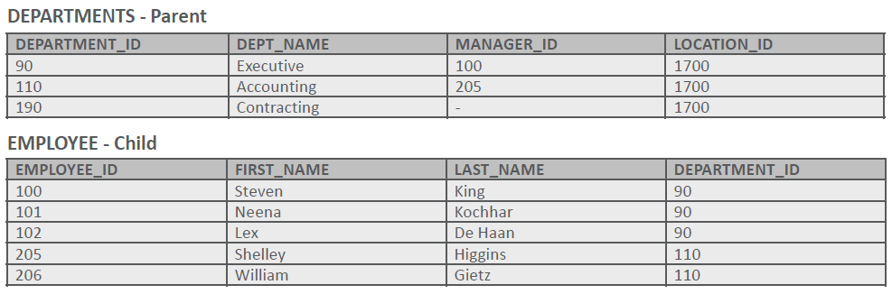
Adding Constraints Example
The following example demonstrates the syntax to add this foreign key to the EMPLOYEES table:
ALTER TABLE employees
ADD CONSTRAINT emp_dept_fk FOREIGN KEY (department_id)
REFERENCES departments (department_id)
ON DELETE CASCADE;

Slide 66
Adding Constraints Conditions
If the constraint is a NOT NULL constraint, the ALTER TABLE statement uses MODIFY in place of ADD.
NOT NULL constraints can be added only if the table is empty or if the column contains a value for every row
Example
ALTER TABLE table_name
MODIFY (column_name CONSTRAINT constraint_name NOT NULL);
ALTER TABLE employees
MODIFY (email CONSTRAINT emp_email_nnNOT NULL);

Slide 67
Dropping Constraints
To drop a constraint, you need to know the name of the constraint.
If you do not know it, you can find the constraint name from the USER_CONSTRAINTS and USER_CONS_COLUMNS in the data dictionary.
The CASCADE option of the DROP clause causes any dependent constraints also to be dropped.
Note that when you drop an integrity constraint, that constraint is no longer enforced by the Oracle Server and is no longer available in the data dictionary.
No rows or any data in any of the affected tables are deleted when you drop a constraint.
ALTER TABLE copy_departments
DROP CONSTRAINT c_dept_dept_id_pkCASCADE;

Slide 68
Cascading Constraints
Cascading referential-integrity constraints allow you to define the actions the database server takes when a user attempts to delete or update a key to which existing foreign keys point.
The CASCADE CONSTRAINTS clause is used along with the DROP COLUMN clause.
It drops all referential-integrity constraints that refer to the primary and unique keys defined on the dropped columns.
It also drops all multicolumn constraints defined on the dropped columns.
If an ALTER TABLE statement does not include the CASCADE CONSTRAINTS option, any attempt to drop a primary key or multicolumn constraint will fail.
Remember, you can't delete a parent value if child values exist in other tables.
ALTER TABLE table_name
DROP(column name(s)) CASCADE CONSTRAINTS;

